Slide 1
Digital Portfolio
STUDENT NAME: MOHAMED RIFATH
REGISTER NO AND NMID: 24134080500121035/E6B2A5A4227BC739C2149C7EB633A438
DEPARTMENT: BCA DEPARTMENT OF COMPUTER SCIENCE
COLLEGE:TBML COLLEGE/ANNAMALAI UNIVERSITY

Slide 2
PROJECT TITLE
Smart Attendance System Using Face Recognition

Slide 3


AGENDA
Problem Statement
Project Overview
End Users
Tools and Technologies
Portfolio design and Layout
Features and Functionality
Results and Screenshots
Conclusion
Github Link
3/21/2024 Annual Review

Slide 4

PROBLEM STATEMENT
Manual attendance systems are time-consuming and prone to errors, leading to inaccurate records and potential for manipulation. There is a need for an automated, reliable, and secure solution to improve attendance management in educational institutions.

Slide 5

PROJECT OVERVIEW
This project proposes a facial recognition-based attendance system that captures and verifies student presence in classrooms. The system automatically marks attendance after identifying each student's face, reducing errors and administrative workload.

Slide 6

WHO ARE THE END USERS?
School and College administrators
Teachers and Faculty
Students

Slide 7

TOOLS AND TECHNIQUES
Programming Language: Python
Libraries/Frameworks: OpenCV, NumPy, Dlib
Database: SQLite
Frontend: Tkinter (Python GUI)
Hardware: Webcam

Slide 8
POTFOLIO DESIGN AND LAYOUT
Homepage: Simple login page for admin and teachers.
Dashboard: View attendance reports and manage student data.
Capture Interface: Real-time video stream for face detection.
Reports: Section for exporting attendance data.
8

Slide 9
FEATURES AND FUNCTIONALITY
Automatic student identification using face recognition.
Real-time attendance marking.
User-friendly GUI for administration.
Attendance report generation and export.
Data security and privacy features.

Slide 10

RESULTS AND SCREENSHOTS
Successfully recognized and marked attendance for enrolled students.
Reduced manual effort and errors in attendance marking.
Example screenshots:
  Login page
  Attendance dashboard
  Face recognition in action
3/21/2024 Annual Review
10

Slide 11
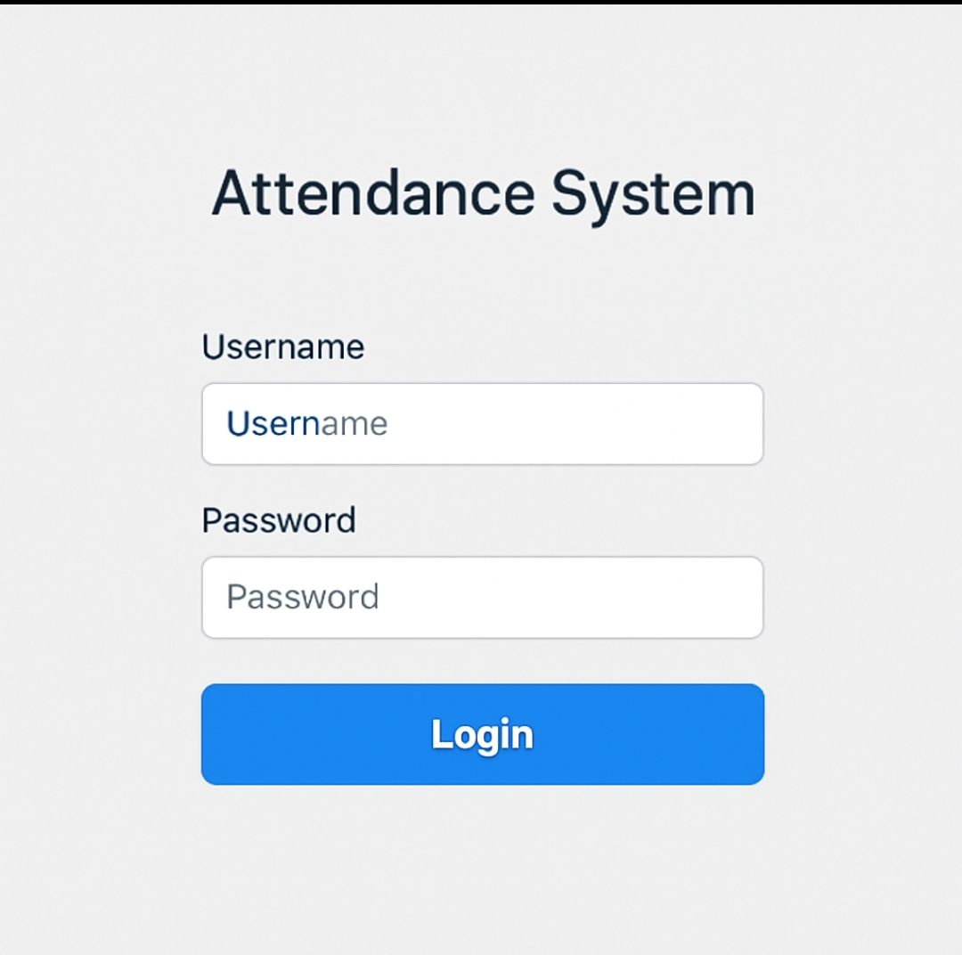
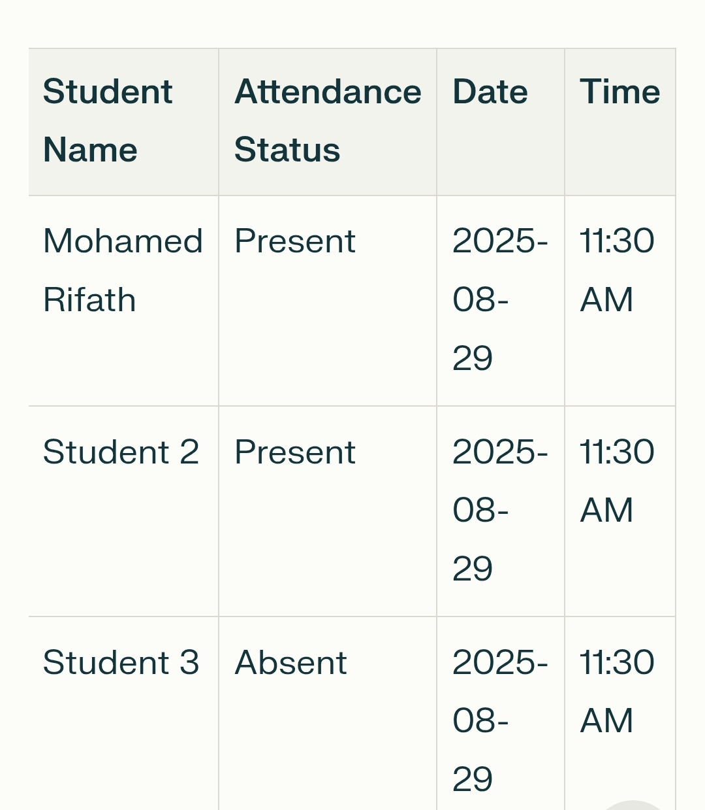
Screenshot

Slide 12
CONCLUSION
The Smart Attendance System streamlines attendance processes, ensuring accuracy and security, and significantly reduces administrative tasks in educational settings. Future enhancements could include cloud integration and mobile access.
12

